Slide 1
Efficient Regression Tests for
Database Application Systems
Florian Haftmann, i-TV-T AG
Donald Kossmann, ETH Zurich + i-TV-T AG
Alexander Kreutz, i-TV-T AG

Slide 2
Conclusions
Testing is a Database Problem
  managing state
  logical and physical data independence

Slide 3
Conclusions
Testing is a Database Problem
  managing state
  logical and physical data independence
Testing is a Problem
  no vendor admits it
  grep for „Testing“ in SIGMOD et al.
  ask your students
  We love to write code; we hate testing!

Slide 4
Outline
Background & Motivation
Execution Strategies
Ordering Algorithms
Experiments
Future Work

Slide 5
Regression Tests
Goal: Reduce Cost of Change Requests
  reduce cost of tests (automize testing)
  reduce probability of emergencies
  customers do their own tests (and changes)
Approach:
  „test programs“
  record correct behavior before change
  execute test programs after change
  report differences in behavior
Lit.: Beck, Gamma: Test Infected. Programmers love writing tests. (JUnit)
Notes:
Do not even think about verification in this environment

Slide 6
Research Challenges
Test Run Generation (in progress)
  automatic (robot), teach-in, monitoring, decl. Specification
Test Database Generation (in progress)
Test Run, DB Management and Evolution (uns.)
Execution Strategies (solved), Incremental (uns.)
Computation and visualization of Δ (solved)
Quality parameters (in progress)
  functionality (solved)
  performance (in progress)
  availability, concurrency, security (unsolved)
Cost Model, Test Economy (unsolved)
Notes:
increased complexity: yes, but also new opportunities (automatic test run generation)

Slide 7
Demo

Slide 8
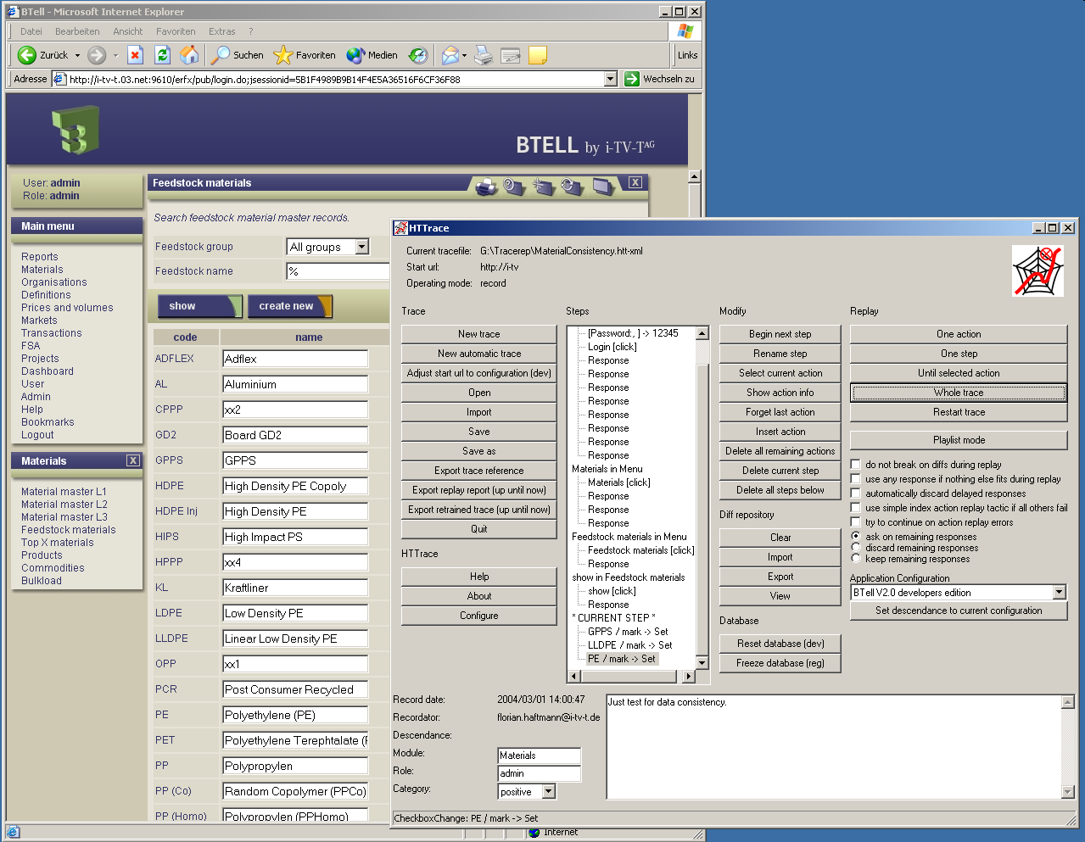

Slide 9
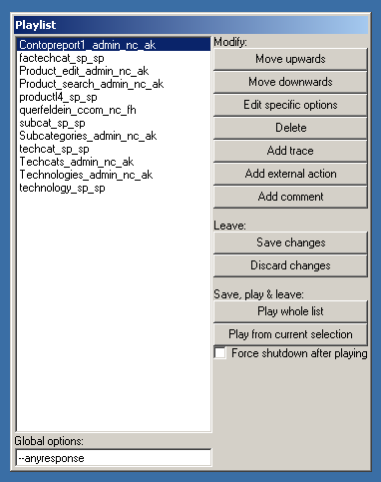
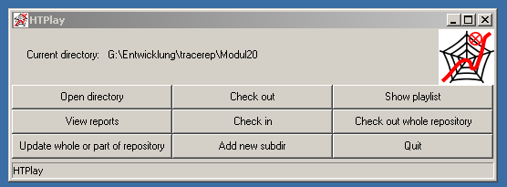
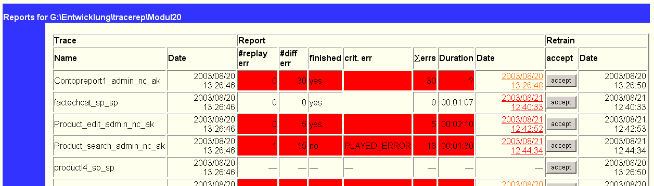

CVS-Repository, enthält Traces nach Gruppen strukturiert in einem Verzeichnisbaum

Slide 10
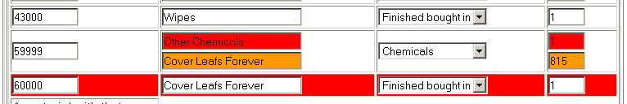
Showing Differences

Slide 11
What is the Problem?
Application is stateful; answers depend on state
Need to control state - phases of test execution
  Setup: Bring application in right state (precondition)
  Exec: Execute test requests (compute diffs)
  Report: Generate summary of diffs
  Cleanup: Bring application back into base state
Demo: Nobody specified Setup (precondition)

Slide 12
Solution
Generic Setup and Cleanup
  „test database“ defines base state of application
  reset test database = Setup for all tests
  NOP = Cleanup for all tests
Test engineers only implement Exec
(Report is also generic for all tests.)

Slide 13
Regression Test Approaches
Traditional (JUnit, IBM Rational, WinRunner, …)
  Setup must be implemented by test engineers
  Assumption: most applications are stateless (no DB)
    (www.junit.org: 60 abstracts; 1 abstract with word „database“)
Information Systems (HTTrace)
  Setup is provided as part of test infrastructure
  Assumption: most applications are stateful (DB)
  avoid manual work to control state!

Slide 14
DB Regression Tests
Background & Motivation
Execution Strategies
Ordering Algorithms
Experiments
Conclusion

Slide 15
Definitions
Test Database D: Instance of database schema
Request Q: A pair of functions
  a : {D} → answer
  d : {D} → {D}
Test Run T: A sequence of requests
  T = <Q₁, Q₂, …, Q_{n}>
  a : { D} → <answer>, a = < a₁, a₂, … a_{n}>
  d : { D} → {D}, d(D) = d_{n}(d_{n-1}(…d₁(D)))
Schedule S: A sequence of test runs
  S = <T₁, T₂, …, T_{m}>
Notes:
test run: granularity of reporting (many reports of the same nature), business process, unit of DB reset
question: what is the right length of a test run? (Too long - difficult to localize bugs; too short: overhead)
schedule: we want to de-activate test runs, reorder test runs

Slide 16
Failed Test Run (strict):
  There exists a request Q in T, a database state D
  Δ(aº, a^{n}) ≠ 0 or dº(D) ≠ d^{n}(D)
  Tº,Qº: behavior of test run, request before change
  T^{n},Q^{n}: behavior of test run, request after change
Failed Test Run (relaxed):
  For given D, there exist a request R in T
  Δ(aº, a^{n}) ≠ 0
Note: Error messages of application are answers, apply Δ function to error messages, too.

Slide 17
Definitions (ctd.)
False Negative:
  A test run that fails although the new version of the application behaves like the old version.
False Positive:
  A test run that does not fail although the new version of the application behaves not like the old version.

Slide 18
Teach-In (DB)
test engineer /
test generation tool
<Q_{i}>
<aº_{i}(D)>
<Q_{i}, aº_{i}(D)>
test tool
repository
<Q_{i}>
<aº_{i}(D)>
applicationO
D -> <dº_{i}(D)>

Slide 19
Execute Tests (DB)
test engineer
Δ(<aº_{i}(D)>,<a^{n}_{i}(D)>)
<Q_{i}, aº_{i}(D)>
test tool
repository
<Q_{i}>
<a^{n}_{i}(D)>
applicationN
D -> <d^{n}_{i}(D)>

Slide 20

False Negative
test engineer
Δ(<aº_{f}(D)>,<a^{n}_{f}(d^{n}_{i}(D))>)
<Q_{f}, aº_{f}(D)>
test tool
repository
<Q_{f}>
<a^{n}_{f}(d^{n}_{i}(D))>
applicationN
d^{n}_{i}(D)

Slide 21
Problem Statement
Execute test runs such that
  There are no false positives
  There are no false negatives
  Extra work to control state is affordable
Unfortunately, this is too much!
Possible Strategies
  avoid false negatives
  resolve false negatives
Constraints
  avoidance or resolution is automatic and cheap
  add and remove test runs at any time

Slide 22
Strategy 1: Fixed Order
Approach: Avoid False Negatives
  execute test runs always in the same order
  (test run always starts at the same DB instance)
Assessment
  one failed/broken test run kills the whole rest
    desaster if it is not possible to fix the test run
  test engineers cannot add test runs concurrently
  breaks logical data independence
  use existing test infrastructure

Slide 23
Strategy 2: No Updates
Approach: Avoid False Negatives (Manually)
  write test runs that do not change test database
  (mathematically: d(D) = D for all test runs)
Assessment
  high burden on test engineer
    very careful which test runs to define
    very difficult to resolve false negatives
  precludes automatic test run generation
  breaks logical data independence
  sometimes impossible (no compensating action)
  use existing test infrastructure

Slide 24
Strategy 3: Reset Always
Approach: Avoid False Negatives (Automatically)
  reset D before executing each test run
  schedules: R T₁ R T₂ R T_{3 …} R T_{n}
How to reset a database?
  add software layer that logs all changes (impractical)
  use database recovery mechanism (very expensive)
  reload database files into file system (expensive)
Assessment
  everything is automatic
  easy to extend test infrastructure
  expensive regression tests: restart server, lose cache, I/O
  (10000 test runs take about 20 days just for resets)

Slide 25
Strategy 4: Optimistic
Motivation: Avoid unnecessary resets
  T₁ tests master data module, T₂ tests forecasting module
  why reset database before execution of T₂ ?
Approach: Resolve False Negatives (Automatically)
  reset D when test run fails, then repeat test run
  schedules: R T₁ T₂ T₃ R T_{3 …} T_{n}
Assessment
  everything is automatic
  easy to extend test infrastructure
  reset only when necessary
  execute some test runs twice
  (false positives - avoidable with random permutations)

Slide 26
Strategy 5: Optimistic++
Motivation: Remember failures, avoid double execution
  schedule Opt: R T₁ T₂ T₃ R T_{3 …} T_{n}
  schedule Opt++: R T₁ T₂ R T_{3 …} T_{n}
Assessment
  everything is automatic
  easy to extend test infrastructure
  reset only when necessary
  (keep additional statistics)
  (false positives - avoidable with random permutations)
Clear winner among all execution strategies!!!

Slide 27
DB Regression Tests
Background & Motivation
Execution Strategies
Ordering Algorithms
Experiments
Conclusion

Slide 28
Motivating Example
T₁: insert new PurchaseOrder
T₂: generate report - count PurchaseOrders
Schedule A (Opt): T₁ before T₂
R T₁ T₂ R T₂
Schedule B (Opt): T₂ before T₁
R T₂ T₁
Ordering test runs matters!

Slide 29
Conflicts
<s>: sequence of test runs
t: test run
<s> → t
if and only if
  R <s> t: no failure in <s>, t fails
  R <s> R t: no failure in <s>, t does not fail
Simplified model: <s> is a single test run.
  does not capture all conflicts
  results in sub-optimal schedules

Slide 30
Conflict Management
T1
<T1, T2, T3> → T4
<T1, T2> → T5
<T1, T4> → T5
T2
T4
T3
T5
T5
T4

Slide 31
Learning Conflicts
E.g.: Opt produces the following schedule
R T₁ T₂ R T₂ T₃ T₄ R T₄ T₅ T₆ R T₆
Add the following conflicts
  <T₁> → T₂
  <T₂, T₃> → T₄
  <T₄, T₅> → T₆
New conflicts override existing conflicts
  e.g., <T₁> → T₂ supersedes <T₄, T₁, T₃> → T₂

Slide 32
Problem Statement
Problem 1:
  Given a set of conflicts, what is the best ordering of test runs (minimize number of resets)?
Problem 2:
  Quickly learn relevant conflicts and find acceptable schedule!
Heuristics to solve both problems at once!

Slide 33
Slice Heuristics
Slice:
  sequence of test runs without conflict
Approach:
  reorder slices after each iteration
  form new slices after each iteration
  record conflicts
Convergence:
  stop reordering if no improvement

Slide 34
Example (ctd.)
Iteration 1: use random order: T₁ T₂ T₃ T₄ T₅
R T₁ T₂ T₃ R T₃ T₄ T₅ R T₅
  Three slices: <T₁, T₂>, <T₃,T₄>, <T₅>
  Conflicts: <T₁,T₂> → T₃, <T₃,T₄> → T₅

Slide 35
Example (ctd.)
Iteration 1: use random order: T₁ T₂ T₃ T₄ T₅
R T₁ T₂ T₃ R T₃ T₄ T₅ R T₅
  Three slices: <T₁, T₂>, <T₃,T₄>, <T₅>
  Conflicts: <T₁,T₂> → T₃, <T₃,T₄> → T₅
Iteration 2: reorder slices: T₅ T₃ T₄ T₁ T₂

Slide 36
Example (ctd.)
Iteration 1: use random order: T₁ T₂ T₃ T₄ T₅
R T₁ T₂ T₃ R T₃ T₄ T₅ R T₅
  Three slices: <T₁, T₂>, <T₃,T₄>, <T₅>
  Conflicts: <T₁,T₂> → T₃, <T₃,T₄> → T₅
Iteration 2: reorder slices: T₅ T₃ T₄ T₁ T₂
  R T₅ T₃ T₄ T₁ T₂ R T₂
  Two slices: <T₅, T₃, T₄,T₁>, <T₂>
  Conflicts: <T₁,T₂> → T₃, <T₃,T₄> → T₅, <T₅, T₃, T₄,T₁> → T₂

Slide 37
Example (ctd.)
Iteration 1: use random order: T₁ T₂ T₃ T₄ T₅
R T₁ T₂ T₃ R T₃ T₄ T₅ R T₅
  Three slices: <T₁, T₂>, <T₃,T₄>, <T₅>
  Conflicts: <T₁,T₂> → T₃, <T₃,T₄> → T₅
Iteration 2: reorder slices: T₅ T₃ T₄ T₁ T₂
  R T₅ T₃ T₄ T₁ T₂ R T₂
  Two slices: <T₅, T₃, T₄,T₁>, <T₂>
  Conflicts: <T₁,T₂> → T₃, <T₃,T₄> → T₅, <T₅, T₃, T₄,T₁> → T₂
Iteration 3: reorder slices: T₂ T₅ T₃ T₄ T₁
  R T₂ T₅ T₃ T₄ T₁

Slide 38
Slice: Example II
Iteration 1: use random order: T₁ T₂ T₃
R T₁ T₂ R T₂ T₃ R T₃
  Three slices: <T₁>, <T₂>, <T₃>
  Conflicts: <T₁> → T₂, <T₂> → T₃
Iteration 2: reorder slices: T₃ T₂ T₁
  R T₃ T₂ T₁ R T₁
  Two slices: <T₃, T₂>, <T₁>
  Conflicts: <T₁> → T₂, <T₂> → T₃, <T₃, T₂> → T₁
Iteration 3: no reordering, apply Opt++:
  R T₃ T₂ R T₁

Slide 39
Convergence Criterion
Move <s₂> before <s₁> if there is no conflict
¬∃ t ∈ <s₁> : <s₂> → t
Slice converges if no more reorderings are possible according to this criterion.

Slide 40
Slice is sub-optimal
conflicts: <T₂> → T₃, <T₃> → T₁
Optimal schedule: R T₁ T₃ T₂
Applying slice with initial order: T₁ T₂ T₃
R T₁ T₂ T₃ R T₃
  Two slices: <T₁, T₂>, <T₃>
  Conflicts: <T₁, T₂> → T₃
Iteration 2: reorder slices: T₃ T₁ T₂
R T₃ T₁ R T₁ T₂
  Two slices: <T₃>, <T₁,T₂>
  Conflicts: <T₁, T₂> → T_{3,} <T₃> → T₁
Iteration 3: no reordering, algo converges

Slide 41
Slice Summary
Extends Opt, Opt++ Execution Strategies
Strictly better than Opt++
#Resets decrease monotonically
Converges very quickly (good!)
Sub-optimal schedules when converges (bad!)
Possible extensions
  relaxed convergence criterion (bad!)
  merge slices (bad!)

Slide 42
Graph-based Heuristics
Use simplified conflict model: T_{x} → T_{y}
Conflicts as graph: nodes are test runs
Apply graph reduction algorithm
  MinFanOut: runs with lowest fan-out first
  MinWFanOut: weigh edges with probabilities
  MaxDiff: maximum fanin - fanout first
  MaxWDiff: weighted fanin - weighted fanout

Slide 43
Graph-based Heuristics
Extend Opt, Opt++ execution strategies
No monoticity
Slower convergence
Sub-optimal schedules
Many variants conceivable

Slide 44
DB Regression Tests
Background & Motivation
Execution Strategies
Ordering Algorithms
Experiments
Conclusion

Slide 45
Experimental Set-Up
Real-world
  Lever Faberge Europe (€5 bln. in revenue)
  BTell (i-TV-T) + SAP R/3 application
  63 test runs, 448 requests, 117 MB database
  Sun E450: 4 CPUs, 1 GB memory, Solaris 8
Simulation
  Synthetic test runs
  Vary number of test runs, vary number of conflicts
  Vary distribution of conflicts: Uniform, Zipf

Slide 46
Real World
Approach
RunTime
R
Iterations
Conflicts
Reset
189 min
63
1
0
Opt
76 min
5
1
0
Opt++
74 min
5
2
5
Slice
65 min
2
3
66
MaxWDiff
63 min
2
6
159

Slide 47
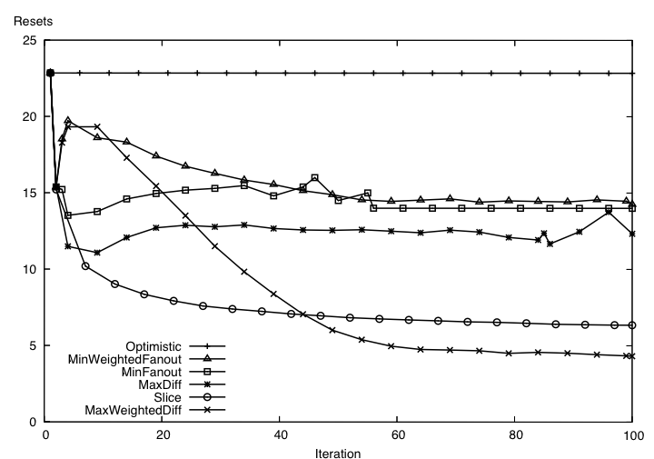
Simulation

Slide 48
DB Regression Tests
Background & Motivation
Execution Strategies
Ordering Algorithms
Experiments
Conclusion

Slide 49
Conclusion
Practical approach to execute DB tests
  good enough for Unilever on i-TV-T, SAP apps
  resets are very rare, false positives non-existent
  decision: 10,000 test runs, 100 GB data by 12/2005
Theory incomplete
  NP hard? How much conflict info do you need?
  Will verification be viable in foreseeable future?
Future Work: solve remaining problems
  concurrency testing, test run evolution, …

Slide 50
Research Challenges
Test Run Generation (in progress)
  automatic (robot), teach-in, monitoring, decl. Specification
Test Database Generation (in progress)
Test Run, DB Management and Evolution (uns.)
Execution Strategies (solved), Incremental (uns.)
Computation and visualization of Δ (solved)
Quality parameters (in progress)
  functionality (solved)
  performance (in progress)
  availability, concurrency, security (unsolved)
Cost Model, Test Economy (unsolved)
Notes:
increased complexity: yes, but also new opportunities (automatic test run generation)

Slide 51
Thank you!

